Slide 1
Ganeti
Cluster Virtual Server Management
James Small
Eric Becker
Valerie Becker

Slide 2
What is Ganeti
Ganeti is a cluster server management software tool built on top of existing virtualization technologies such as Xen or KVM.
Google originally started Ganeti in 2005-2006 as a VMware alternative for managing virtual machines, storage and networks - not as a cloud platform.
Was originally name XenCluster.
Change to an open source project in 2007 using GPLv2

Slide 3
What is Ganeti
Ganeti requires the virtualization software to be preinstalled on your servers in order to function
Once installed, it will take over the management part of the virtual instances:
Disk Creation Management
Operating System Installation
Startup / Shutdown
Failover between physical systems

Slide 4
What is Ganeti
Designed to facilitate cluster management of virtual servers
Provide fast and Simple recovery after physical failures
Google uses Ganeti in their internal corporate environment to facilitate cluster management of virtual servers in commodity hardware, increasing the efficiency of hardware usage and saving space, power and cooling.

Slide 5
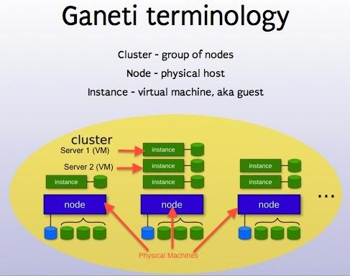

Slide 6
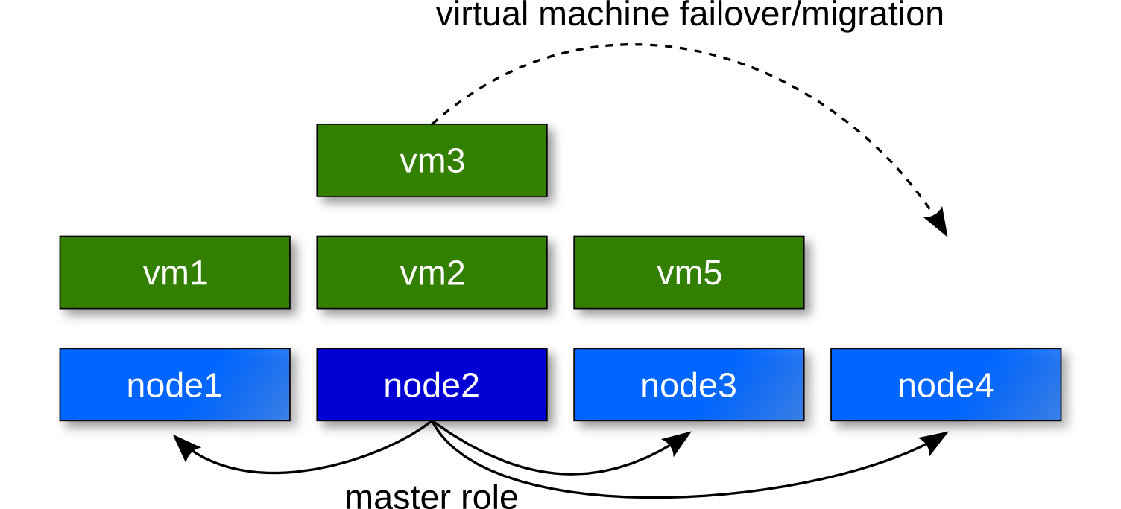
Failover / Migration

Slide 7
Features for Managed Instances
Support for Xen Virtualization
Support for PVM and HVM Instances
Live Migration Support
Virtual console or VNC to control instances
Support for virtio or emulated devices
Support for KVM virtualization.
Live Migration Support
Support for fully virtualized instances
Support for VNC or serial access
Support for virtio or emulated Devices

Slide 8
Features for Managed Instances
Recommended Cluster size of 1-40 physical nodes
Disk Management
Plain LVM Volumes
across-the-network raid1 (using DRBD) for quick recovery in case of physical system failure
Instance disk partition supported
Automated instance migration across clusters

Slide 9
Requirements Ganeti
Xen 3.0 or above (KVM v72 or above)
DRBD
RBD
LVM / LMV2
OpenSSH
Python / Python Open SSL bindings
simplejson, pyparsing, pyinotify, PycURL
socat, Paramiko
bridge utilities

Slide 10
Xen & setup
yum -y install kernel-xen xen
uname -r or uname -a
vi /boot/grub/menu.lst
Make sure the ''kernel'' is set to the xen kernel and add the LVM group to the end
ro root=/dev/VolGroup00/LogVol00
Change default number to the correct kernel '0' in this case.

Slide 11
Xen & setup
Restart machine and then run the
uname -r or uname -a again to see if you are in the xen kernel.
Centos has a tool for creating vms
virt-install --prompt
xm create : starts a vm
xm shutdown <name> : stops vm.
xm destroy <name> : stops vm without shutting down
xm list : list of the vms running
xm console <name : logs into vm

Slide 12
Ganeti & setup
First download Ganeti from Googles repos.
this includes ganeti and Deboostrap
code.google.com/p/ganeti/downloads/list
Create directories:
mkdir /etc/ganeti /srv/ganeti /srv/ganeti/os /srv/ganeti/export
# service ganeti restart
# gnt-cluster init 'nameofmaster'
# gnt-node add 'nodename'

Slide 13
Ganeti Pros
High Availability and Resiliency
Can generally perform faster than other cloud environments and at a lower hardware cost
Simple to Setup and Maintain
Ideal for smaller installations
Works well will commodity hardware
Dramatically reduces the number of physical machines.
Keeps the operational overhead of virtualization low

Slide 14
Ganeti Cons
Simplicity can also be a challenge
Does not automatically shift resources when a node fails. Someone has to be there.
Command Line Driven, No nice web interface to deal with out of the box (There is 3rd party web interfaces)

Slide 15
Developer Community
Community still quite small.
Very helpful and responsive
End users on the mailing lists are quite helpful and usually quick to respond as well

Slide 16
Open Source Tools for Ganeti
The Oregon State University Open Source Lab has developed a few open source tools for Ganeti, including:
Ganeti Web Manager (See Next Slide)
Ganeti Instance Image
Twisted VNCAuthProxy

Slide 17
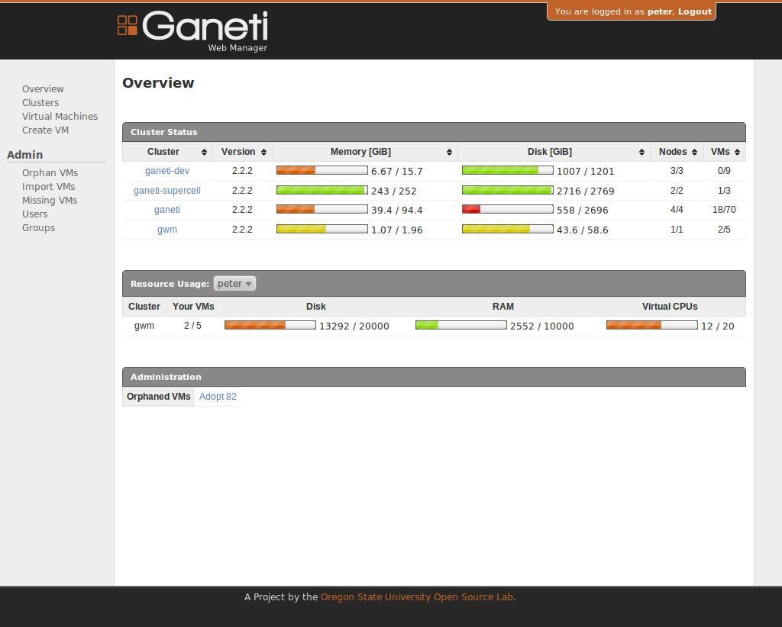

Slide 18
Who is using Ganeti?
Google (Corporate Computing Infrastructure)
grnet.gr ( Greek Research & Technology Network)
osuosl.org (Oregon State University Open Source Lab)
fsffrance.org ( French Free Software Foundation)

Slide 19
Conclusion
Useful for smaller installations but can't handle larger infrastructures as easily.
Install base seems limited still.
It really depends on your particular infrastructure.
This quote sums it up well: "It really boils down to what you need. Other platforms have a lot of other useful features but it generally comes with a lot of angst, in building, testing and deploying more complex systems."

Slide 20
Links / Resources
http://code.google.com/p/ganeti/
http://www.linuxfoundation.org/news-media/blogs/browse/2012/09/building-private-cloud-open-source-ganeti-pros-and-cons
http://everythingsysadmin.com/2010/05/another-ganeti-success-story.html

